Slide 1
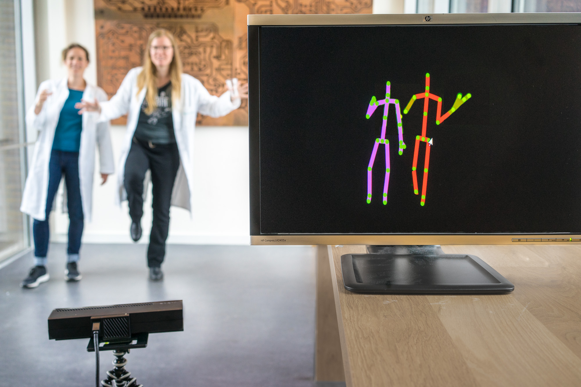
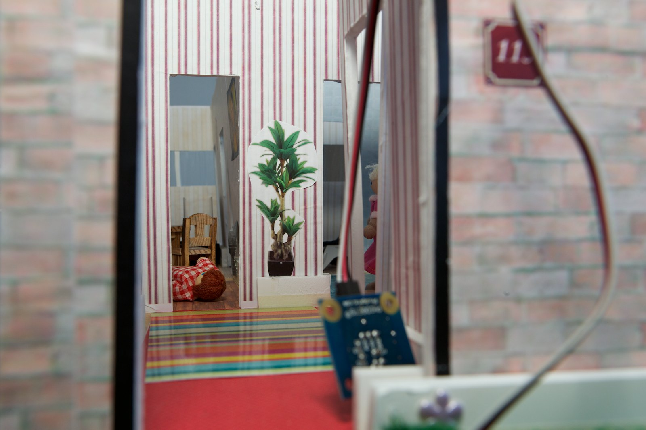
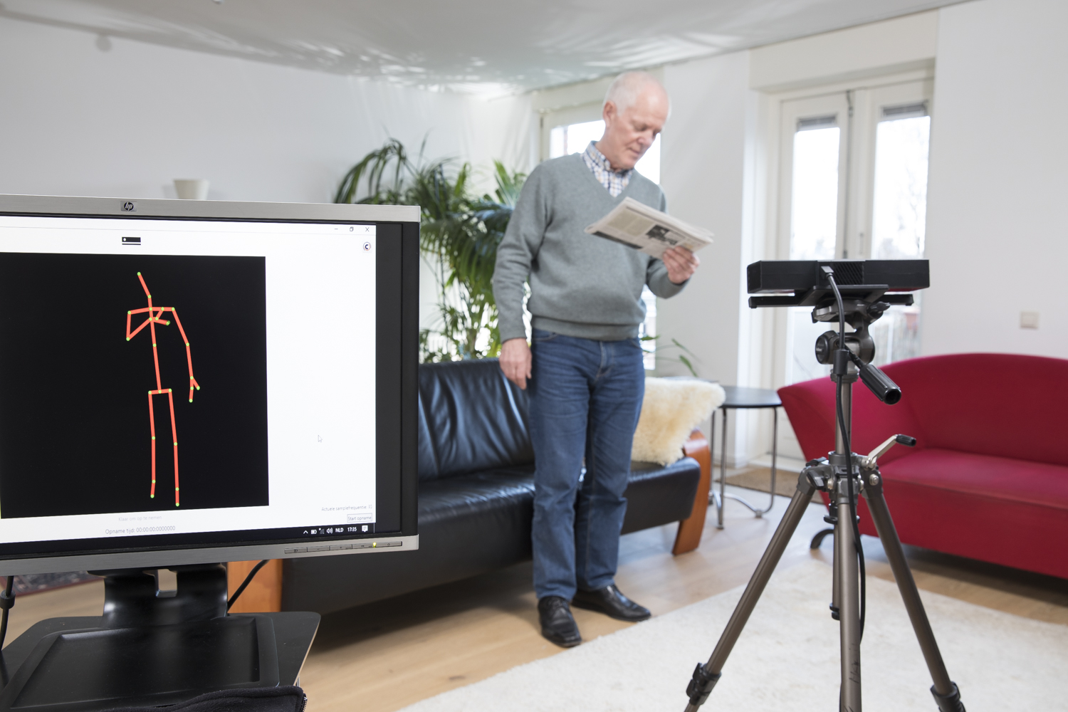
BRAVO
Fall Risk at a Festival
Saskia Robben, Kickoff “Leren en beslissen”, 7 January 2019
Notes:
Wie ben ik?
Problem statement:
Vallen voorkomen zonder vrijheid in te perken

Slide 2
Outline
BRAVO project & fall risk
BRAVO Lowlands Science pilot
Problem/goals
Demo
Q&A

Slide 3
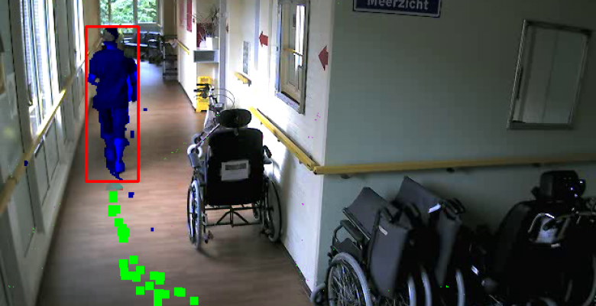
BRAVO
Bewegings-
Registratie en
Analyse voor
Valrisicoschatting bij
Ouderen
Inschatten valrisico…
…in de woonomgeving
…in het ziekenhuis
Partners:
Lectoraat Digital Life (HvA) Lectoraat Oefentherapie (HvA), Lectoraat Fysiotherapie (HvA), Cinnovate, Eagle Vision Systems, 17Rabbits, Maastricht Instruments, Digifit, Brevidius, Motek Medical, Glimworm, VicarVision, Vahlkamp International, Academisch Medisch Centrum (AMC), Vrije Universiteit (VU), Vilans, VeiligheidNL, Cordaan, Amsta.
Funded by SIA Raak-MKB
Notes:
Wat was BRAVO ook al weer?
HEEL KORT, geleidelijk vs. accuut
Introductie context BRAVO.
Primair valpreventie (door inschatten risico), geen valdetectie
Verschil ziekenhuis (urgent) & thuis (geleidelijke achteruitgang, bv door verlies spiermassa)

Slide 4
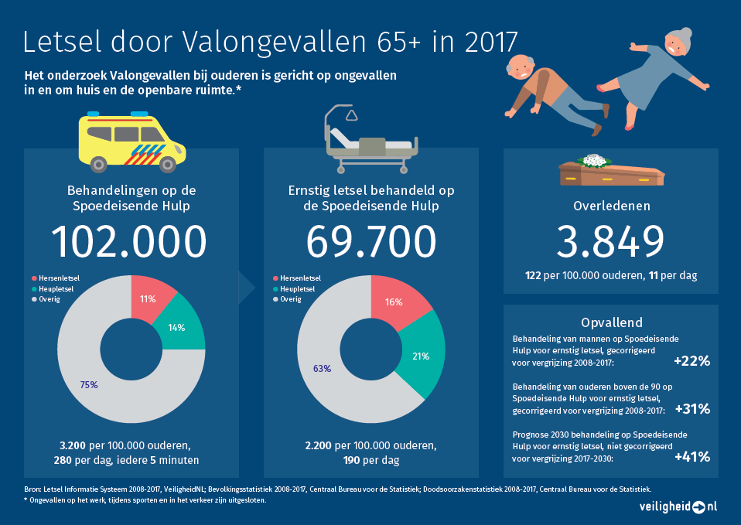
Falls
<insert screenshot veiligheid.nl flyer>

Slide 5
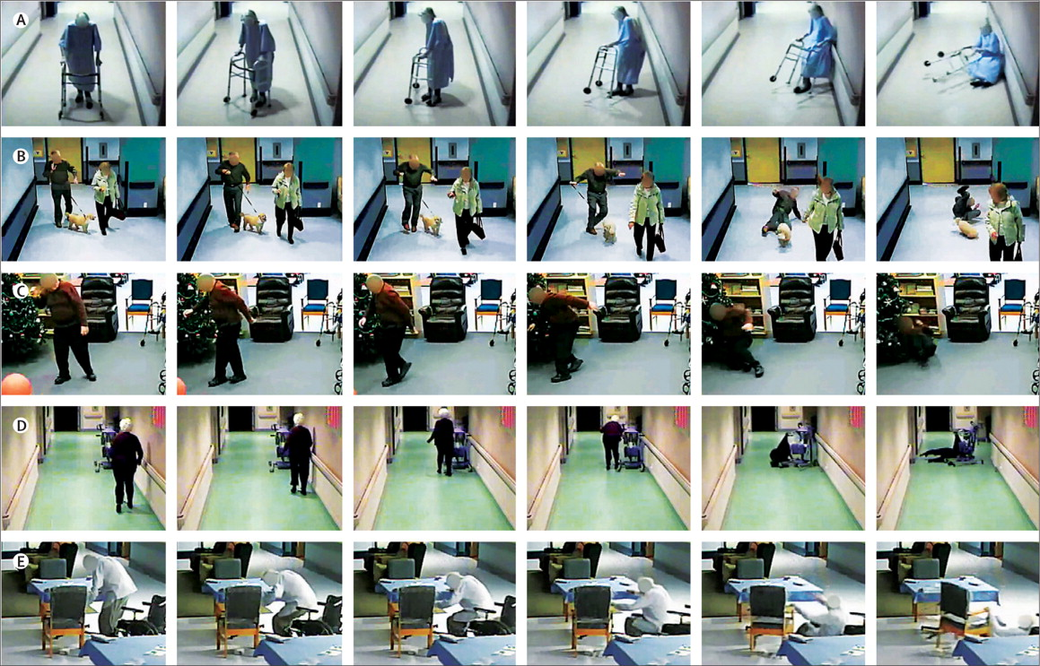
Lancet 2013;381:47-54
Slide van Nathalie van der Velde
Notes:
Mensen vallen op verschillende manieren.
Slide van Nathalie van de Velde (internist-geriater AMC)

Slide 6
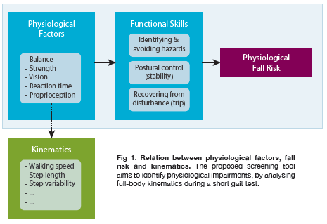
Relation movement & falls
Gait analysis for screening increased fall risk
Simple tests: POMA, TUG, FoF
High between-subject variation in movement
Relation falls & physiological impairments
Notes:
- physical problems underlying increased fall risk, such as balance problems, reduced strength, cause changes in gait pattern.
- Insert 'Fall risk factors diagram here
- for this reason, clinician use movement tests (e.g. POMA, TUG) to identify problems

Slide 7
Towards automatic screening
Currently screening:
Always need professional
Limitation of clinical tests (e.g. not discriminative, subjective)
Qualitative gait analysis in lab (expensive equipment, resources)
BRAVO approach:
Qualitative gait analysis
cheap equipment (Kinect sensor), can be conducted on location, automated analysis
Clinicians are able to recognize anomalous gait within a few steps using their "clinical eye" and experience.

Slide 8
BRAVO pilots
Goal: Automatic screening of fall risk
Preferably also provide information of specific risk factor (e.g. disturbed balance, reduce limb strength)
Assessment of participants 65+
High between subjects-variety
Hence... Lowlands Science Pilot:
Measure many participants and vary a single factor (within subject): i.e. distorted depth vision

Slide 9
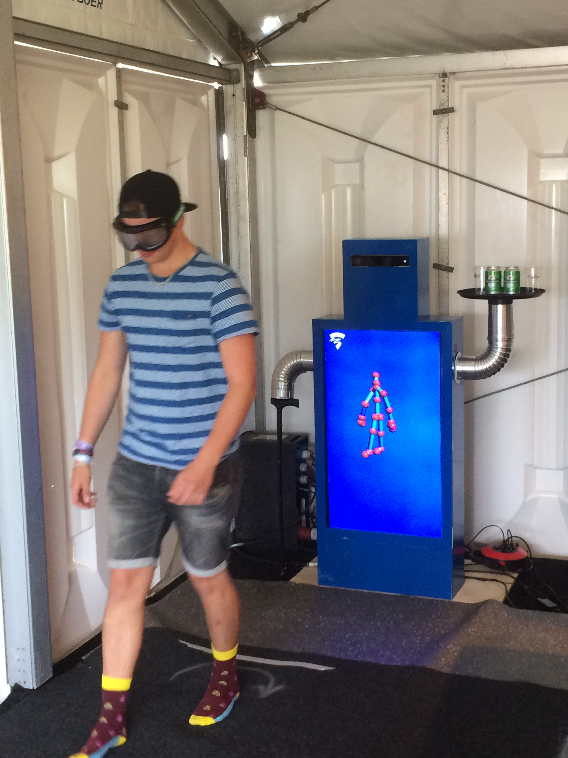
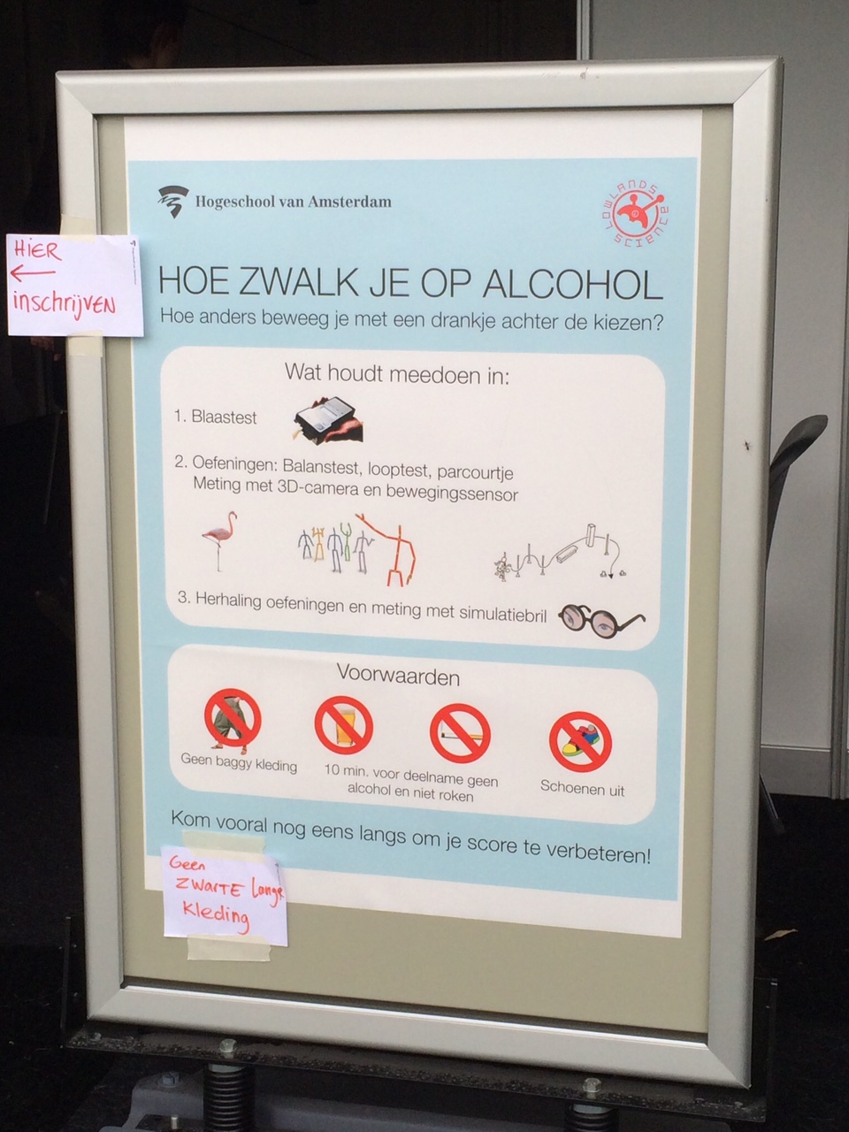
BRAVO Lowlands pilot
<insert footage>

Slide 10
Methods I/II
205 participants
Test protocol included:
Rising from a chair, 4x3m walking at comfortable speed and sitting down. This was repeated in two conditions:
Control
Glasses: Distorted depth vision (induced by simulation goggles)

Slide 11
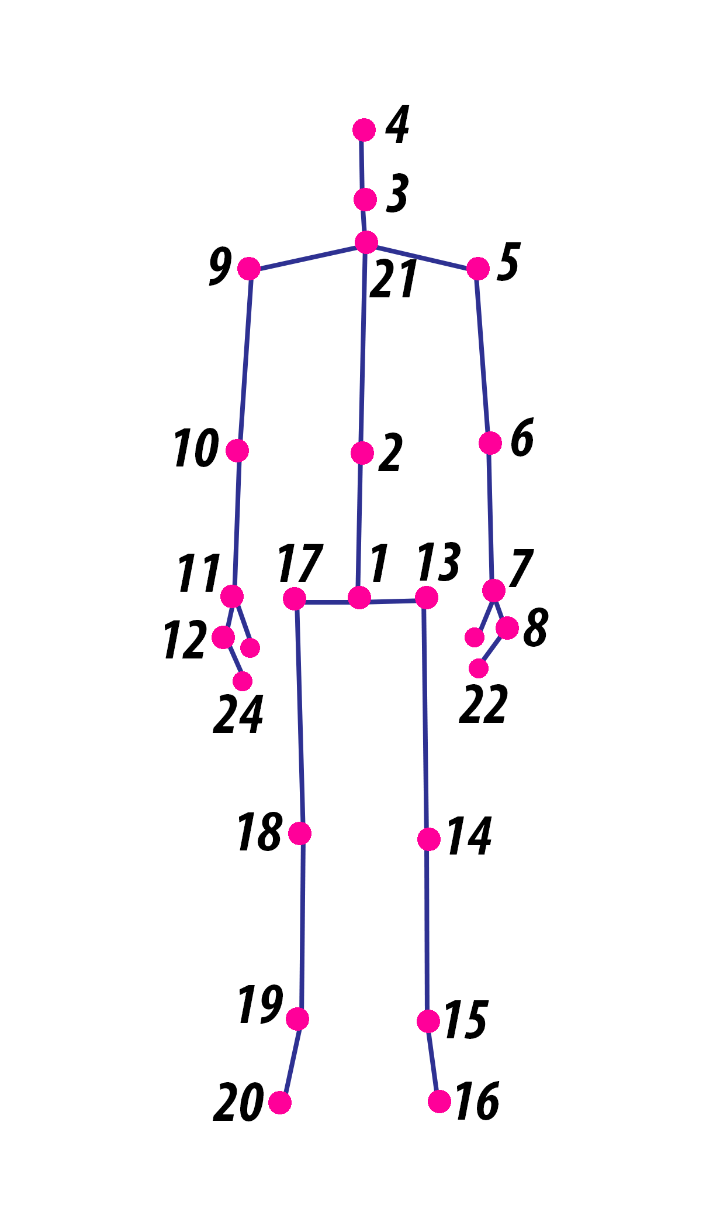
Methdos II/II
Sensor:
Microsoft Xbox One Kinect
Preprocessing:
Remove erroneous data
Segmentation of gait sections
Low-pass filtering
3d data of 1 joint (mid-spine) selected.
(See fig 2 for example projections of the resulting data)

Slide 12
Problem / goal:
Task: make a classifier that can differentiate between the two conditions (control vs. glasses)
Product:
Comprehensive report & source code
Include comparison of classifiers / effect of improvements
Metrics: common classification metrics (e.g. accuracy, roc, auc)
Preferred programming language: Python (or R)
Notes:
When depth vision is distorted, most people walk differently. As humans we can clearly see this, but the question is whether we can automatically differentiate between these two types of walks.

Slide 13
Data description
See full description in provided document
testID: Unique ID of Test; For example "169B03" is subject ID 169; condition B (with glasses distorting vision); third walk (approx 3 walks per person)
SegmentData: Contains the actual xyz data of the spine-mid point

Slide 14
Python example code (to help loading the matlab-datafile)
# Load the matlab file
from scipy.io import loadmat
matdata = loadmat("../Data/SpineMidData_21032018.mat")
# Remove some irrelevant matlab metadata
spineMidData=matdata['SpineMidData']
# Inspect the headers:
spineMidData[:1]
# Get a column of data
spineMidData[:,0]
# SegmentData
# contains the actual xyz data of the spine-mid point. In the jpg's you see an example of a 2d projection of such walks
#note: number of frames is not the same for all walks
#note2: similar data exists for all joints that software for kinect stored. This data is not yet preprocessed.
spineMidData[:,7]

Slide 15
Bonus problems
Use different labels
Classify no/low or high alcohol intake
(Similar as main goal, only different labels.)
Predict continuous alcohol score (regression)
Use balance score (labels are less reliable because data was obtained from a suboptimal balance test)
Is it possible to detect balance from walks?
With this problem: only use the walks without glasses, as the glasses do distort the walks but don't distort the balance test
Simulate “real world” problem by using only one condition for each person (select randomly)
Use all the other data (joints) (not yet preprocessed)
Use a related dataset (older adults performing a similar task) (not yet preprocessed)

Slide 16
Glasses demo
OPTIONAL!
Only voluntary as people can get nauseous.

Slide 17
Contact moments
Walk-in:
Location: HvA/TTH http://www.hva.nl/locaties/hva-locaties/theo-thijssenhuis.html
Days: Monday / Wednesday / Thursday
{14, 21, 28}
Email: s.m.b.robben@hva.nl

Slide 18
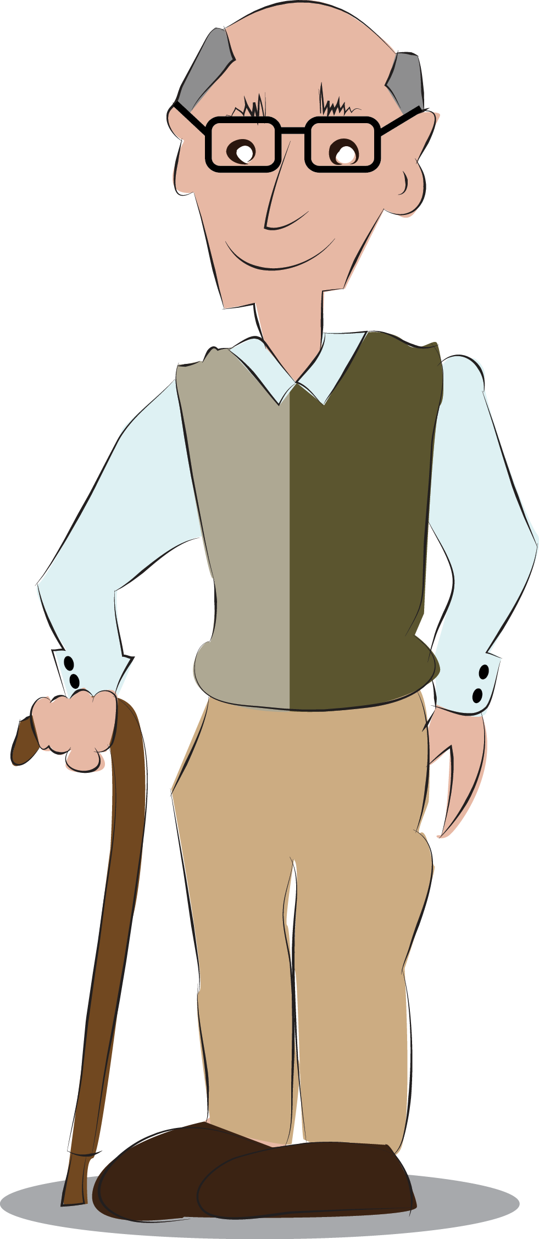
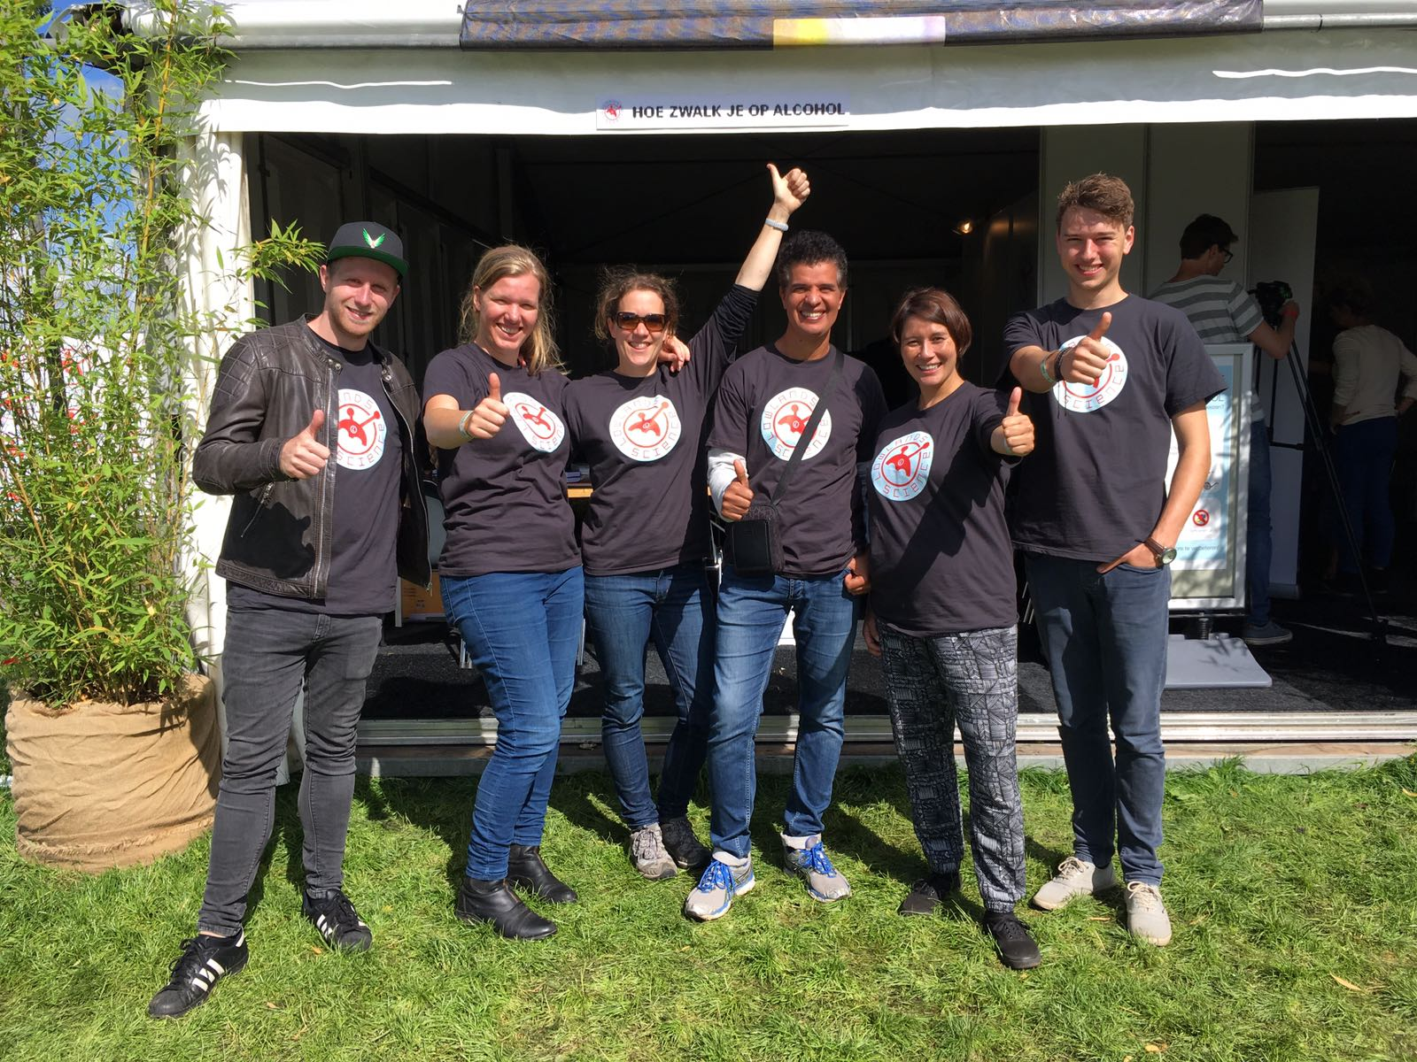
Questions?
Saskia Robben
s.m.b.robben@hva.nl
www.digitallifecentre.nl/team/saskia-robben
Main contributor: Aukje de Vrijer

